Slide 1
Middle Eastern Biology of Parasitism 2017
Layla El Moussawi
PhD Student
American University of Beirut

Slide 2
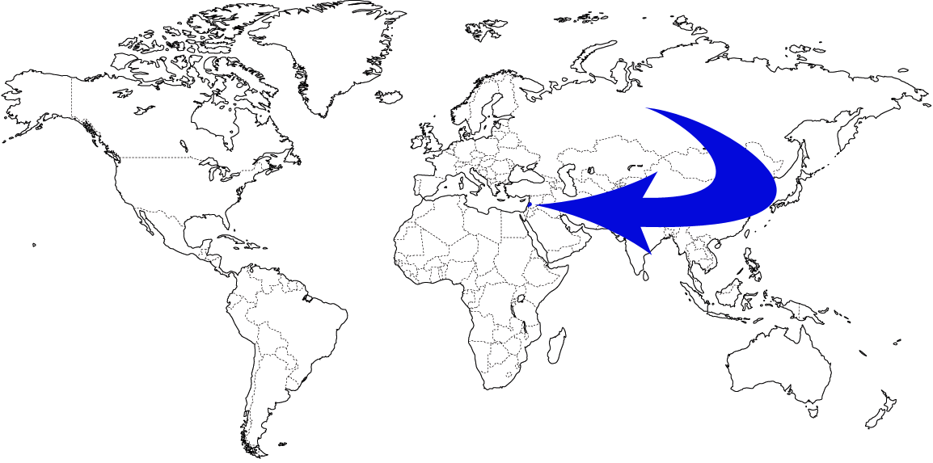
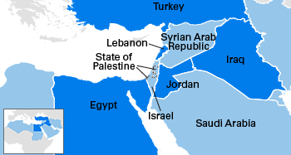
Lebanon

Slide 3


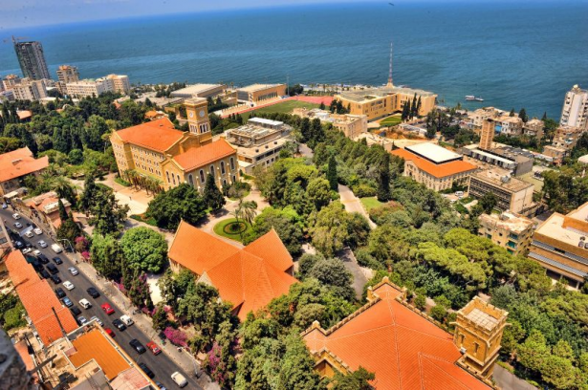

Slide 4
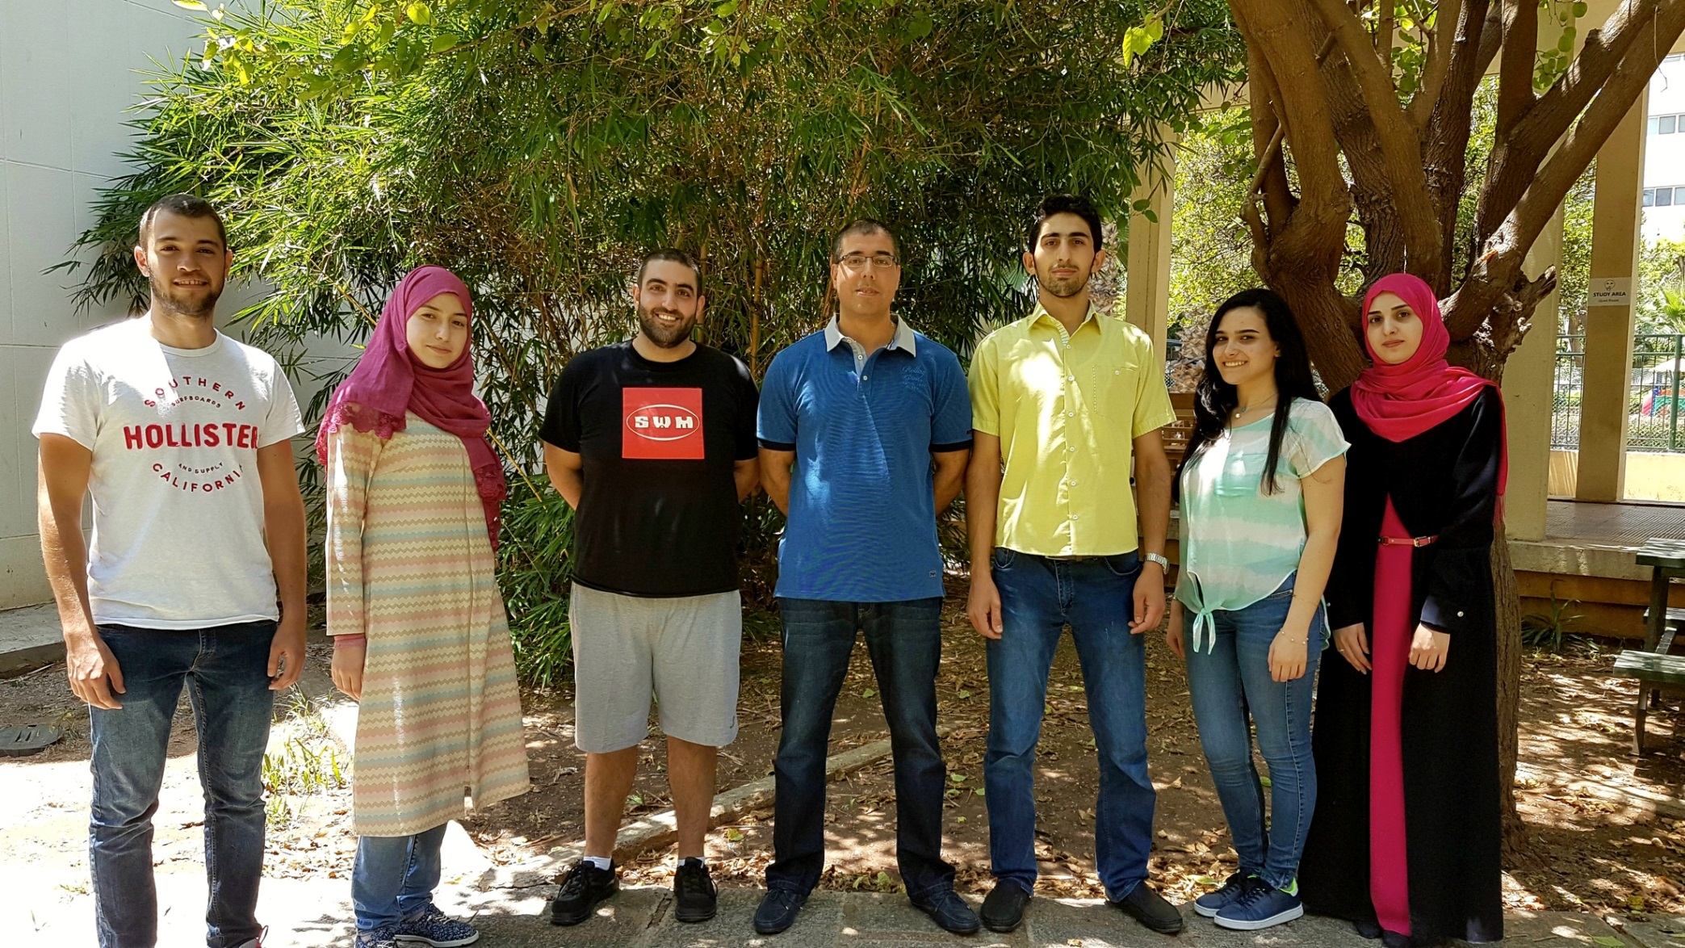
Vector Biology Lab Dr. Mike Osta

Slide 5
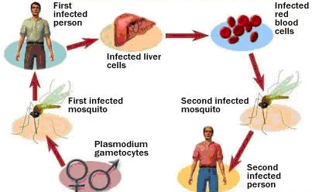
Malaria Transmission Cycle

Slide 6
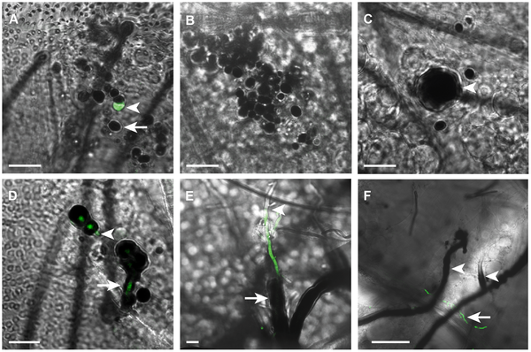
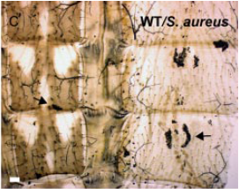
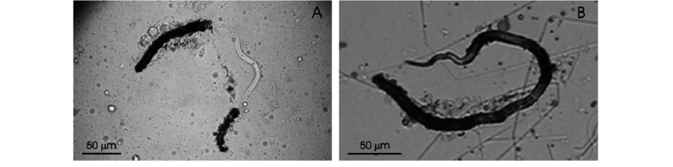
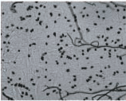
Melanization
Notes:
Melanization is a potent immune response unique to arthropods characterized by the deposition of a thick melanin coat around the invader eventually resulting in its death .
Expression of defensin, cecropin, and transferrin in Aedes aegypti (Diptera: Culicidae) infected with Wuchereria bancrofti (Spirurida: Onchocercidae), and the abnormal development of nematodes in the mosquito.
Yassine H, Kamareddine L, Osta MA (2012) The Mosquito Melanization Response Is Implicated in Defense against the Entomopathogenic Fungus Beauveria bassiana. PLOS Pathogens 8(11): e1003029. https://doi.org/10.1371/journal.ppat.1003029
http://journals.plos.org/plospathogens/article?id=10.1371/journal.ppat.1003029
Melanization reaction is not required for survival of anopheles gambaie mosq after bacterial infection

Slide 7
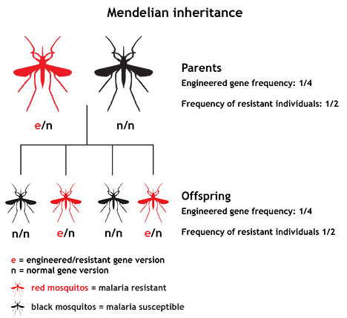
Melanization
Selective Genetic
Crosses
CTL4 knockdown
Susceptible
(Infectious)
Refractory
(Melanizing)
Notes:
Genetic selection of a plasmodium refractory strain of the malaria vector anopheles gambaie
ed. The produc- tion of genetically defined lines of vector mosquitoes refractory to the development of the parasite and thus incapable of transmit- ting the infection is one possible method for controlling mal
2). The line is highly or fully refractory to three isolates of P. vivax and one of P. ovale
Of six P. falciparum isolates examined, the refractory line fully encapsu- lates almost all ookinetes of two New World isolates from El Salvador and B
Phenotypic Dissection of a Plasmodium-Refractory Strain of Malaria Vector Anopheles stephensi: The Reduced Susceptibility to P. berghei and P. yoelii
Of the 400 anopheline species worldwide, only 40 are important malaria vectors. One of these, Anopheles gambiae, may transmit Plasmodium falciparum, the parasite responsible for the cerebral form of malaria in much of sub-Saharan Africa. The L3–5 Plasmodium-refractory strain of A. gambiae was isolated from the G3 colony using genetic selection for resistance to simian malaria P. cynomolgi infection, and the 4Arr susceptible strain was selected from a combination of colonies from Liberia and Kenya [1]–[3]. A subsequent study demonstrated that polymorphisms of a single gene encoding antiparasitic thioester-containing protein 1 (TEP1) explain a substantial part of the variability in parasite susceptibility [4]. The genetic loci related to P. falciparum infection intensity have been identified through quantitative trait loci analysis of isofemale colonies [5], [6]. Both field and laboratory inter-species studies of Plasmodiumrefractoriness have been conducted with various combinations of Anopheles and Plasmodium[7]–[9]. Comparisons between the Plasmodium susceptibility of different anopheline mosquitoes represent a fundamental contribution to the understanding of parasite-mosquito interactions and suggest that genetic diversity raises vectorial capacity, based on intricate dyadic interactions.
we made use of a refractory strain of A. gambiae (R), which completely aborts development of a number of malaria parasites, including the simian parasite P. cynomolgi B. Refractoriness is manifested by melanotic encapsulation of the ookinete, after it completes its passage through the mosquito midgut (Collins et al., 1986). The genetic control of refractoriness appears to be complex. It not only involves several quantitative trait loci, but also the relative contribution of each locus to oocyst encapsulation varies with the species of parasites (Zheng et al., 1997, 2003). A different refractory mechanism resulting in complete lysis of P. gallinaceum ookinetes in the midgut was reported in A. gambiae(Vernick et al., 1995). To date, the molecular mechanisms underlying both types of refractoriness, and more generally parasite recognition and killing, are not well understood.

Slide 8
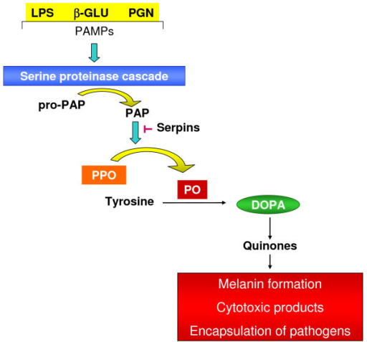
Melanization Cascade
??
Garcia et al.,2009, Parasites &Vectors

Slide 9
Serine Protease Homologue : CLIPA16
Novel CLIP-SPH (AGA10730): CLIPA16
Aim 1:
Functional genetic analysis of CLIPA16 in mosquito immunity
Aim 2:
Molecular characterization of CLIPA16
Notes:
we aimed to characterize CLIPA16 at the functional and molecular levels using genetic, molecular and proteomic tools in order to precise ultimately its exact hierarchical position in the mosquito melanization response

Slide 10
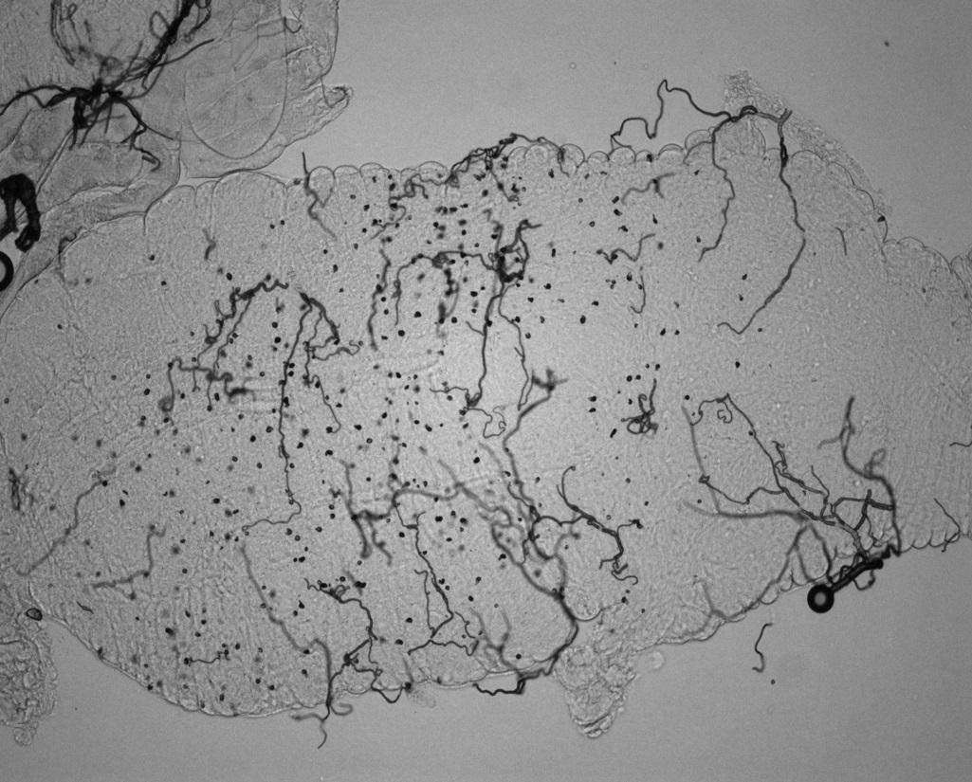
CLIPA16 is Required for Parasite Melanization
GFP-expressing Ookinetes
Melanized Ookinetes

Slide 11
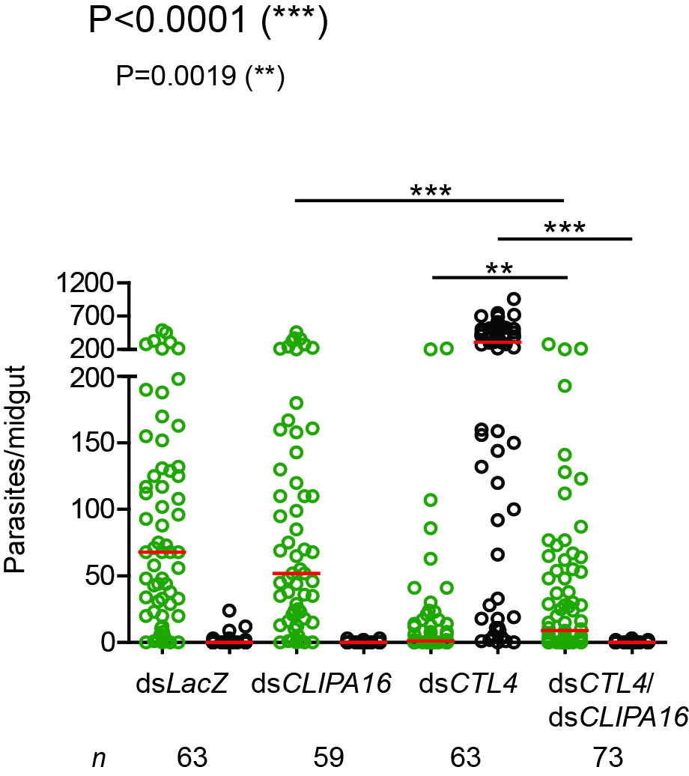
CLIPA16 is Required for Parasite Melanization

Slide 12
CLIPA16 Regulatory Cascade
SPCLIP1
CLIPA2
TEP-1
cSP
CLIPA8
SRPN2
CLIPA14
cSP
CLIPA16
Melanization
Notes:
Such a cascade hasn’t been described before, particulary for this type of clip
In summary , in additon to functionally characterizind a new SPH , we are the first to describe regulatoery cascade for sph
TEP-1 regulated by a2, a14 and spclip1 activates a cSP which in tiurn cleaves A8 that mediates the activation of clipa16 and induction of the melanization rxn via another csP .

Slide 13
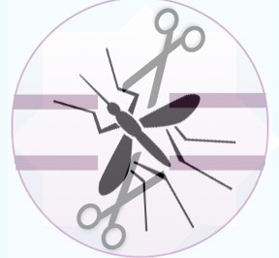
Mosquito Micromanipulation
Genetics
Recombinant DNA
Molecular cloning
Transcript Analysis
Reverse Genetics
Proteomics
Recombinant Proteins
Western Blots
CO-IP & MS
Biochemistry
Enzymatic Activity Assays
Microscopy
Flourscent
Confocal
Electron

Slide 14
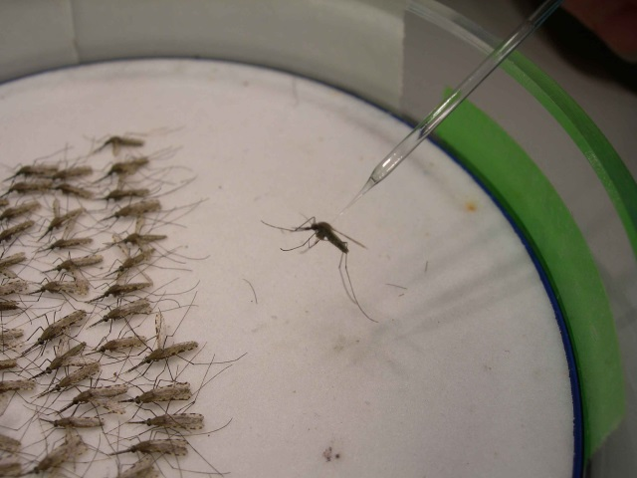
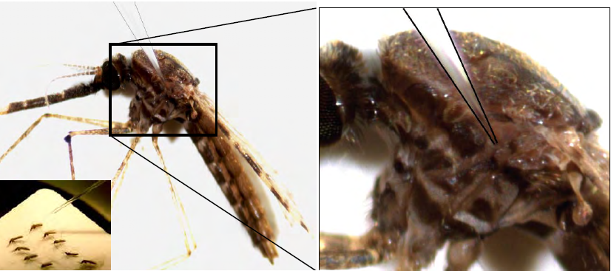
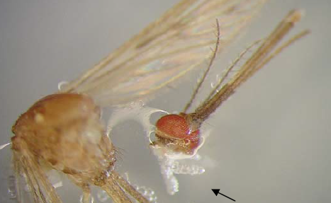
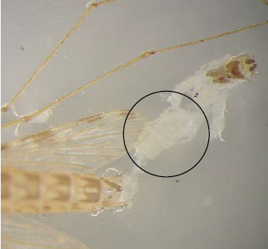
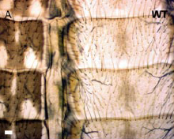
Mosquito Micromanipulation & Dissection
Microinjection
Microdissection
Salivary glands
Midguts
Abdomens
Methods in Anopheles Research , 4th Edition , 2014

Slide 15
Mosquito-Parasite Interactions
Mosquito Genetic Factors
Mosquito –Parasite
Interactions
Plasmodium Genetic Factors
Notes:
Our work will benefit from a
Full understanding of disease development and transmission requires a bilateral approach that focuses on both the host and the pathogen .
Our work will strongly benefit from collaborative expertise in parasite genetics and genome-editing technologies that would facilitate the simultaneous manipulation of mosquito and Plasmodium,
the idea is to create screen different mutant parasites against mosquitoes of various genetic backgrounds so that we can identify the interactive partners acting at the interface organsism and more precisely map parasite immune evasion mechanisms , particularly those that target CLIP proteases.
genotypes to assess their underlying interactive phenotypes. Exposing transgenic parasites to different host genetic backgrounds will more precisely map the immune pathways targeted by malaria evasion mechanisms. The molecular components of this cross-talk would presumably serve as suitable candidates for the development of transmission blocking vaccines

Slide 16
Research Difficulties
Insufficient Funding
Importation Difficulties
Lack of Communication

Slide 17


